Slide 1

Investing to Cab company
Islombek Pulatov

Slide 2

Provide actionable insights to help XYZ firm in identifying the right company for making investment.

Slide 3
Data Analysis
The analysis has been divided into four parts:
Data Understanding
Forecasting profit and number of rides for each cab type
Finding the most profitable Cab company
Recommendations for investment

Slide 4
17 Features( including 5 derived features)
Timeframe of the data: 2016-01-31 to 2018-12-31
Total data points :359392
Assumptions:
Outliers are present in Price_Charged feature but due to unavailability of trip duration details ,we are not treating this as outlier.
Profit of rides are calculated keeping other factors constant and only Price_Charged and Cost_of_Trip features used to calculate profit.
Users feature of city dataset is treated as number of cab users in the city we have assumed that this can be other cab users as well(including Yellow and Pink cab)

Slide 5
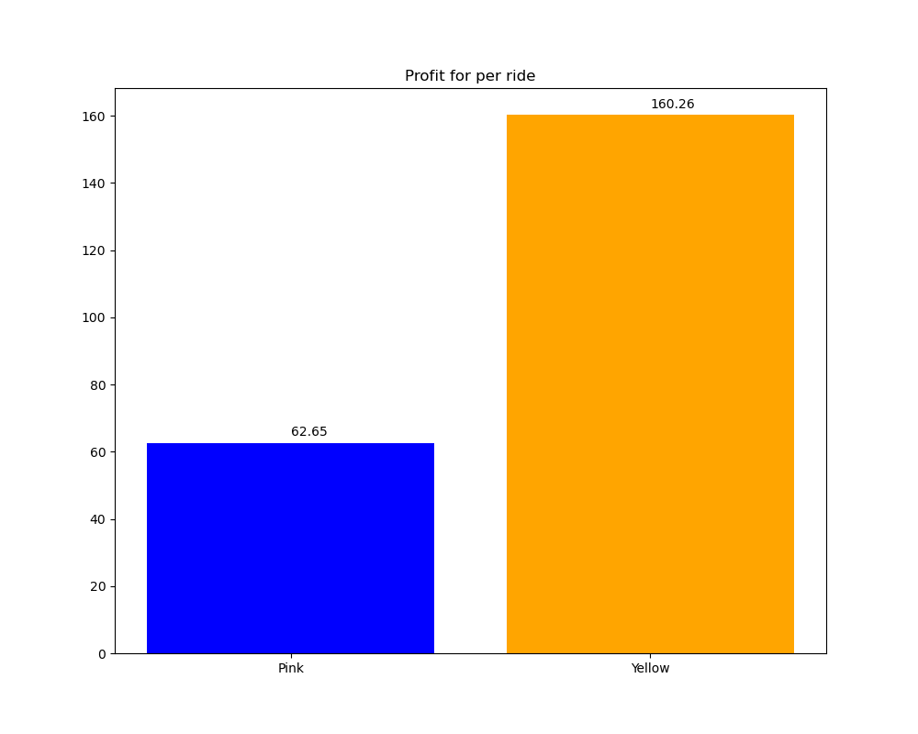

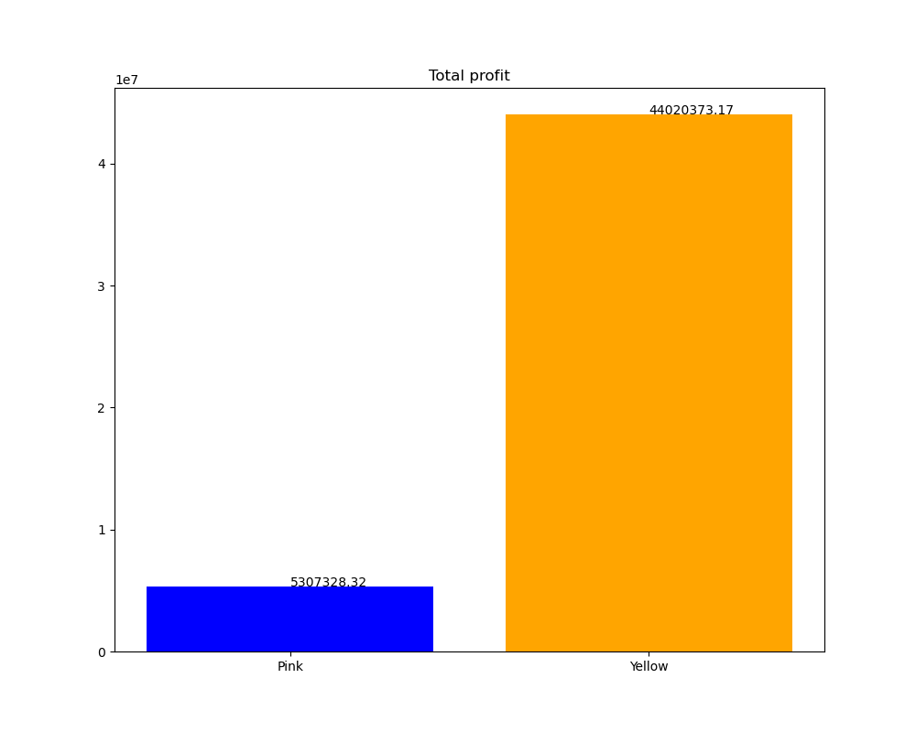
Profit Analyses
Company | Profit | Total rides | Profit per ride | Profit per km
Pink Cab | 5,307,328 | 84,711 | 62.65 | 2.78
Yellow Cab | 44,020,373 | 274,681 | 160.26 | 7.10

Slide 6
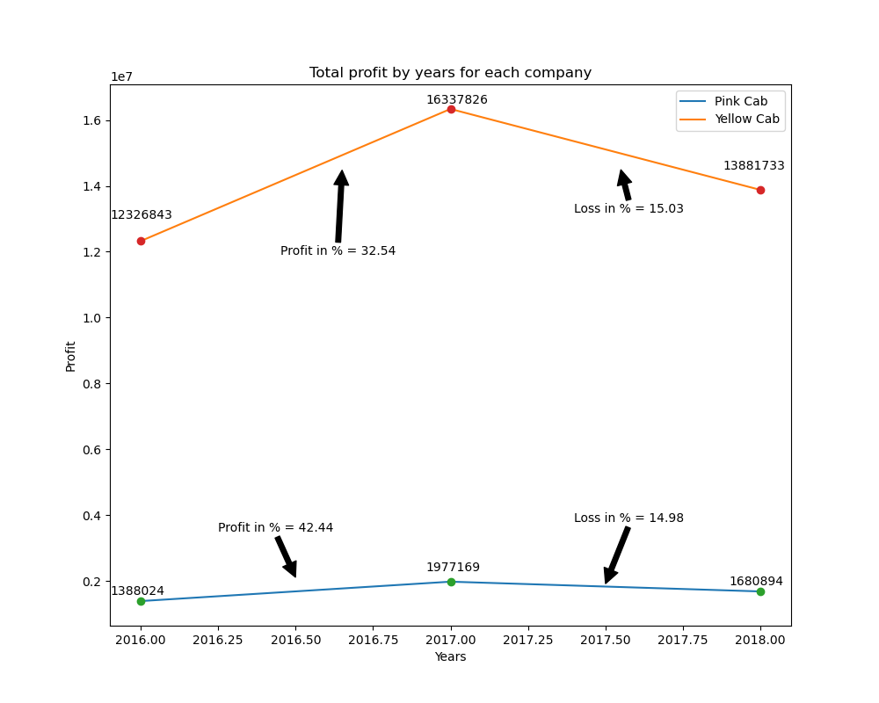
Yearly Profit Analysis

Slide 7
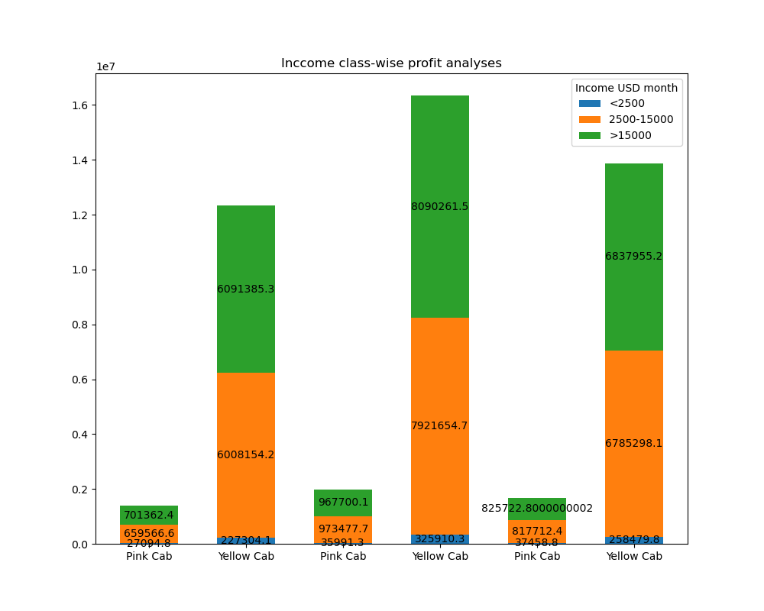
Income Class wise Profit and customer base
Analysis
Middle class
and high class
contributes
more in the
profit as well as
in the customer
base of both the
cabs

Slide 8
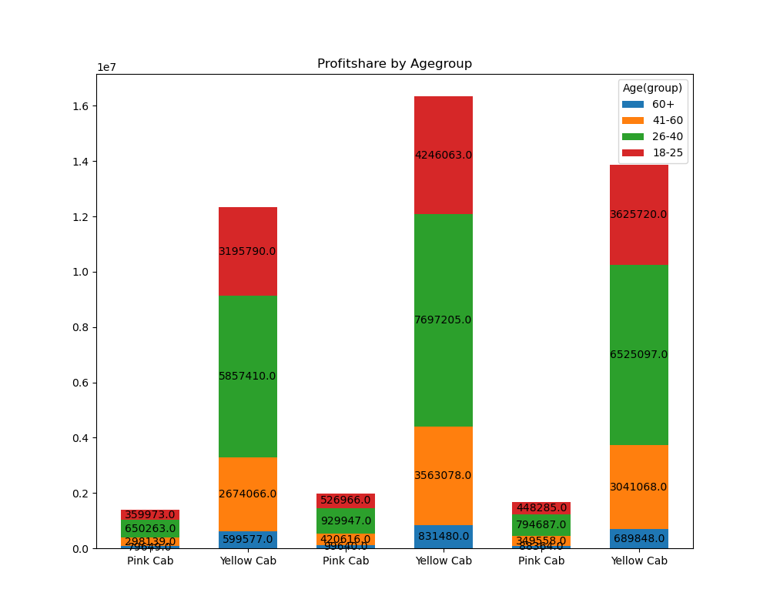
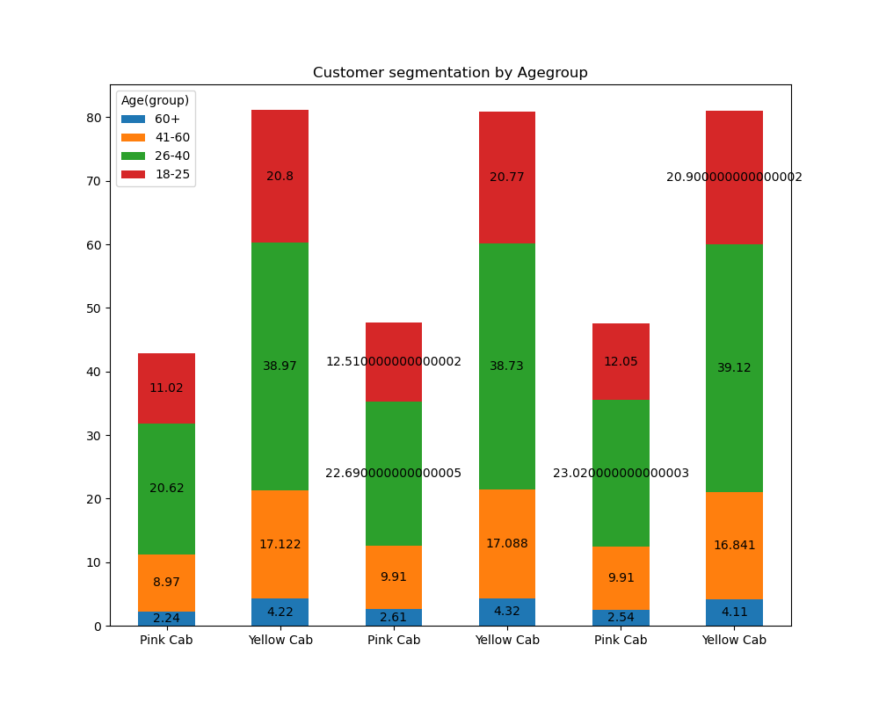
Age GroupWise Profit And Customer Base
Analysis

Slide 9
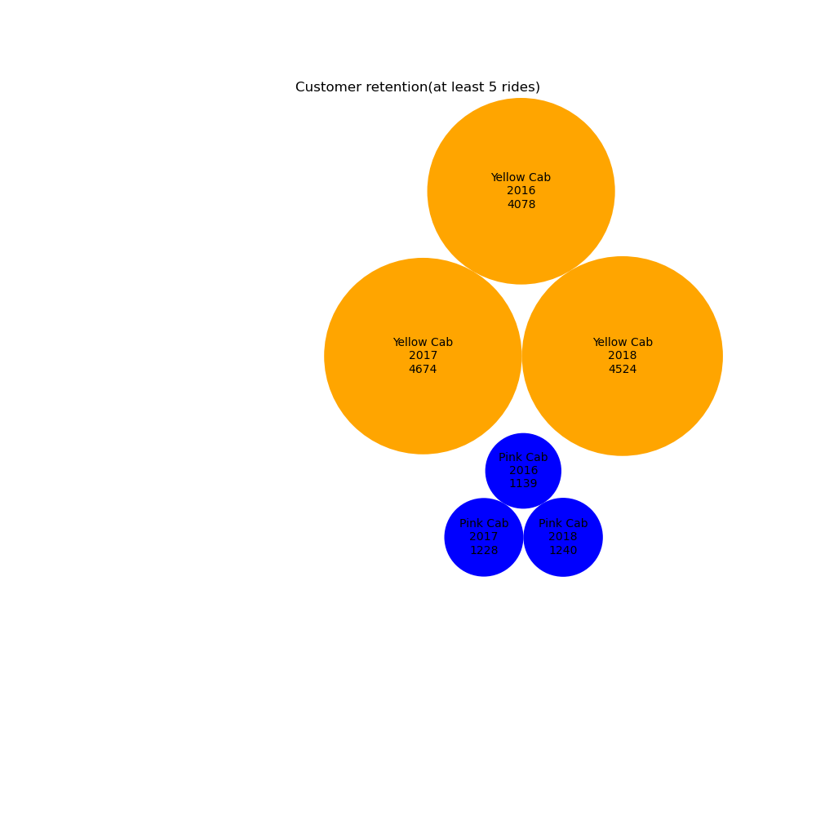
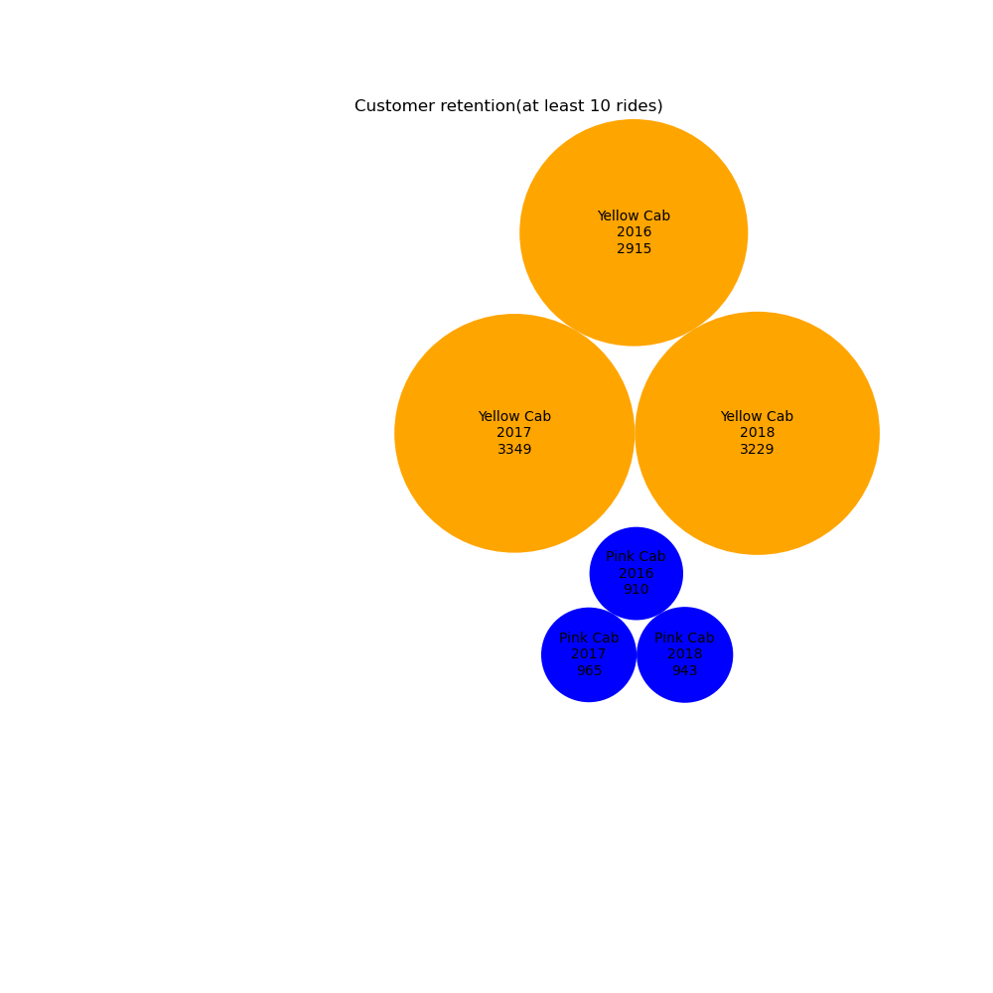
Customer Retention
Customer retention (at least 5 rides)
Customer retention (at least 10 rides)
Clearly in both the
segments Yellow cab is far
better than Pink cab.Which shows Yellow cab is able to retain their
customers well as
compared to Pink cab.

Slide 10
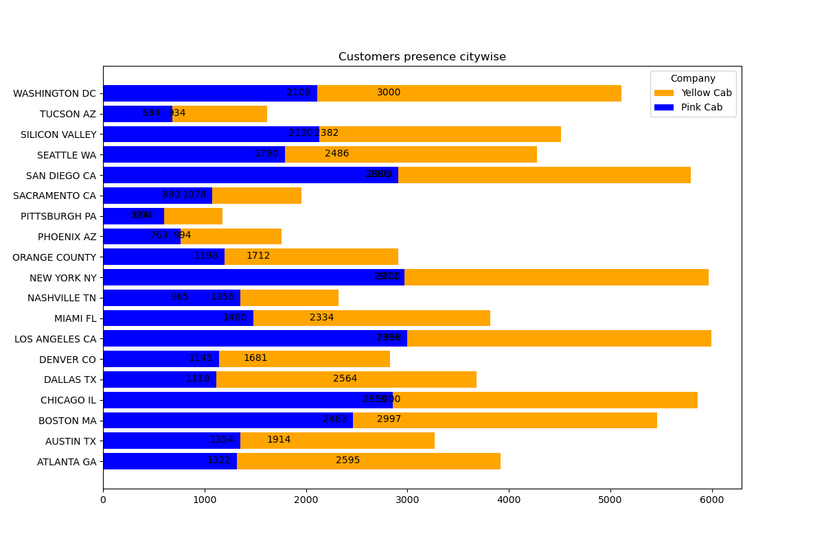
Customer Presence of Yellow and Pink cab city wise
Out of 19 Cities Pink cab have higher customer reach as compared to Yellow cab , in
following 4 cities:
SanDiego
Nashville
Sacramento
Pittsburgh

Slide 11
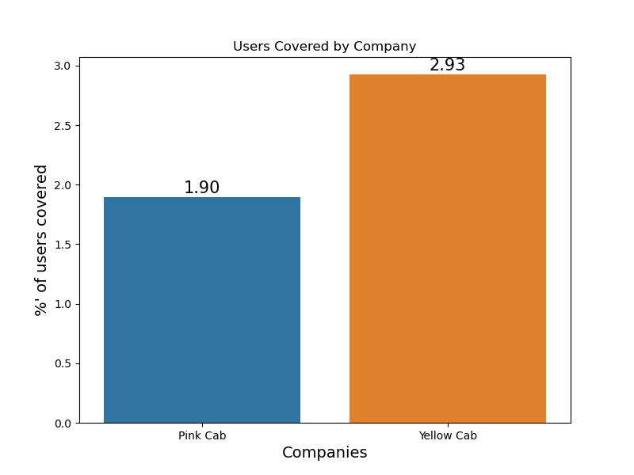
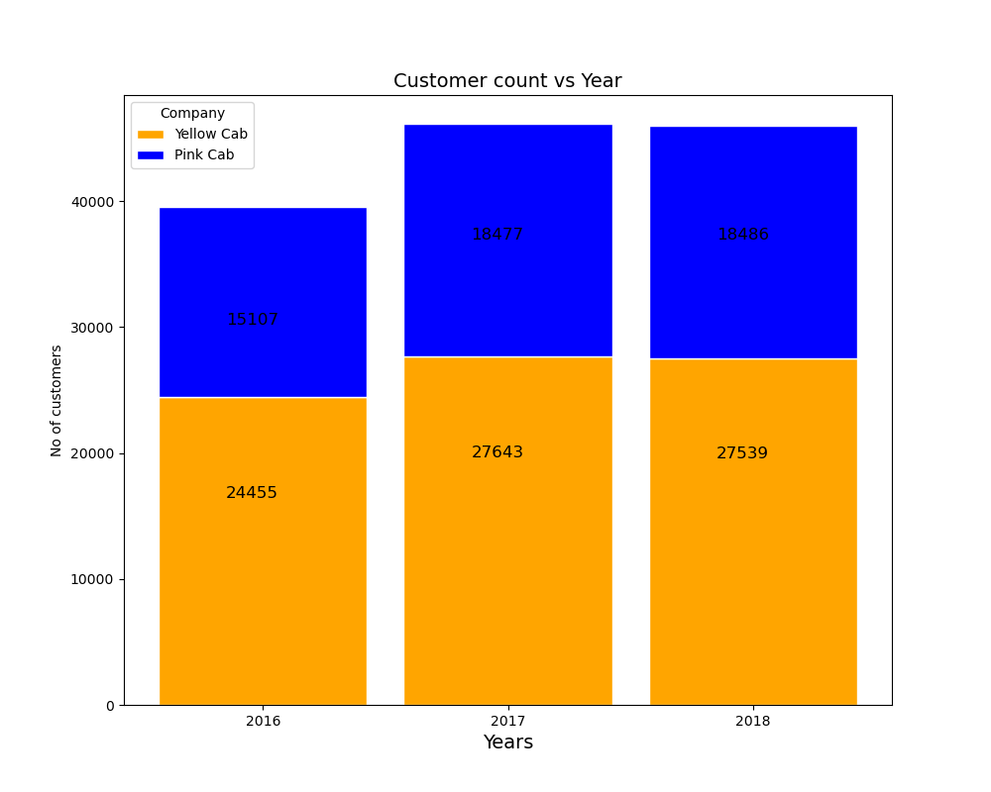
User Covered by Company and Customer base Year
wise
Yellow cab has reach of around 2.93% cab users while Pink cab has 1.90% reach.
I have considered all cab users present in 19 cities to calculate Yellow and Pink cabs coverage.
Yellow cab higher customer base as compared to Pink cab.

Slide 12
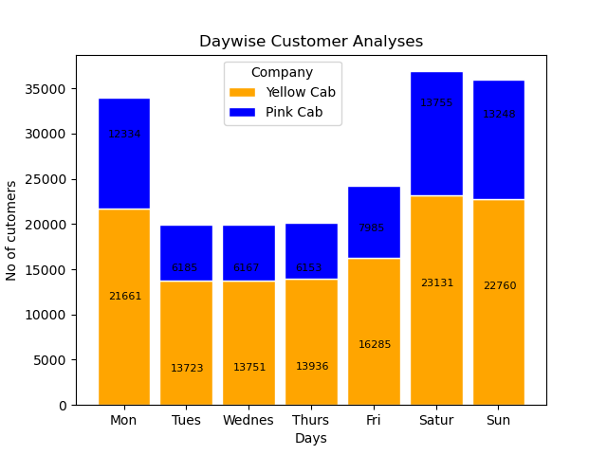
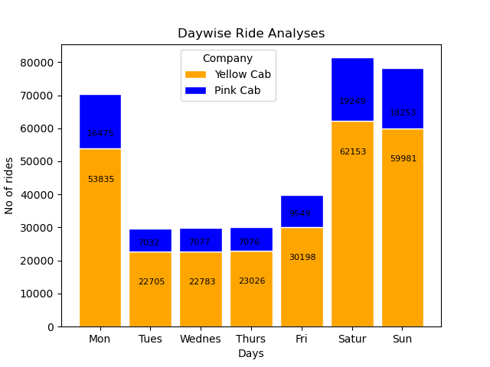
Customer And Ride Analysis Day Wise

Slide 13
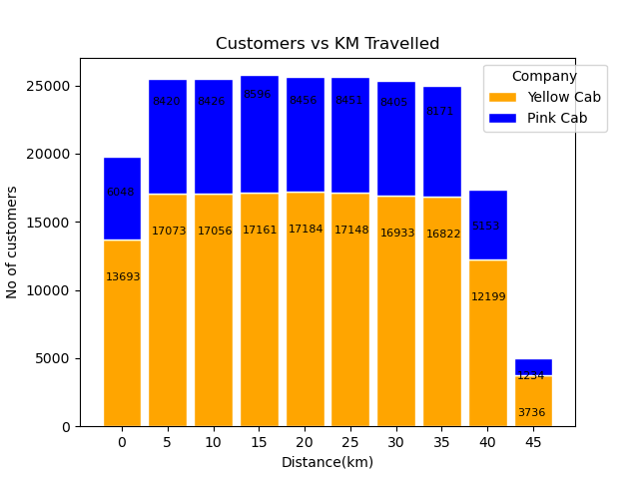
Customer analysis based on ride distance
Yellow cab has customers almost uniform for short, medium and long trip. Which shows yellow cab is offering better customer plan for short, medium and long Trip.
5-35 KM trips are contributing more In both the cabs profit
There is a huge difference between yellow and pink cab in customer reach for short and long trip. Yellow cab has very good customer reach in this segment as well

Slide 14
Profit forecasting for 2019

Slide 15
Recommendations
I have evaluated both the cab companies on following points and found Yellow cab better than Pink cab:
Customer Reach: Yellow cab has higher customer reach in 15 cities while Pink cab has higher customer reach in 4 cities. I have also observed that Yellow cab is doing good in covering other cab users as compared to Pink cab.
Customer Retention: I have analyzed this in two segments : at least 5 drive and at least 10 drive with the same cab company. And I found that Yellow cab is doing far better than Pink cab in both these segments.
Age wise Reach : Yellow cab has customer in all age group and it’s been observed that it’s even popular in 60+ age group as equally as its in 18-25 age group.
Average Profit per KM: Yellow cab’s average profit per KM is almost 2.5 times the average profit per KM of the Pink cab.
Income wise Reach: Both the cabs are very popular in high and medium income class but here also Yellow cab is performing better than Pink cab in offering their services to all the three income class group (low, medium and high)
Ride count and Profit Forecasting: Both the companies are facing loss in the profit and no. of ride. Yellow cab’s forecasted profit loss is around 1.83% while Pink cab’s loss in 3.1%.Pink cab is facing more loss even when its forecasted no of ride loss is lesser than Yellow cab.
On the basis of above point , I will recommend Yellow cab for investment.

Slide 16
Thank you!

